Slide 1
Lecture 18 Hashing Hash Tables

Slide 2
Recap of BSTs
BSTSs offer O(log n) time costs for add/remove/find operations by exploiting order relationships among data.
They are also memory efficient, in that only as many nodes are allocated as elements are contained in the BST
However…

Slide 3
…
..by utilizing more memory (greater space complexity), we can achieve even higher performance (lower time complexity)
Hash sets, hash tables and hash maps offer O(1+alpha*) time costs for add/remove/find operations by investing more memory in the underlying storage.
* load factor

Slide 4
Simple setup
Suppose you were developing a program to access employee records for a small company with 1000 employees.
Also every employee has been given a number from 1 (the founder), to 1,000 (the most recently hired worker).
Class employee {
int id; //key
String firstName, lastName;
String position;
}

Slide 5
Simple example
Class employee {
int id; //key
String firstName, lastName;
String position;
}
In this application, the key would be worker’s id, and value associated with the key would be the whole Employee record.

Slide 6
What Date Structure should you use?
Employees are seldom laid off, but even when they are, their records remain in the database for reference (concerning retirement benefits and so on).
A: Array
B: Linked List
C: Heap
D: Binary Tree
E: Something new, I’m not sure what.

Slide 7
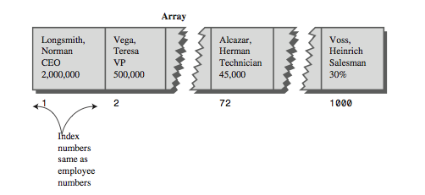
One possibility is an array
Each employee record occupies one cell of the array, and the index number of the cell is the employee number for that record.

Slide 8
Complexity?
For a given problem and a solution, how fast can we add/find given an employee id?
A: O(1), O(n)
B: O(n), O(1)
C: O(1), O(1)
D: O(n), O(n)
E: can’t tell

Slide 9
Answer
Both add/find require only O(1), if the id is known.
Presumably, the array is made somewhat larger than the current number of employees, to allow room for expansion, but not much expansion is anticipated.
Problem: Often our keys are not so nicely ordered.

Slide 10
Finite “universe” of objects to store
In this application (and others), there may exist only a finite universe of possible keys values.
Sometimes this finite set of keys is small enough that we can allocate an array big enough to give every possible key its own slot.
In this case, we can make the “search” process for a particular key trivial
We simply “jump” to the unique array index assigned to that key.
This takes only O(1) time in the worst-case.

Slide 11
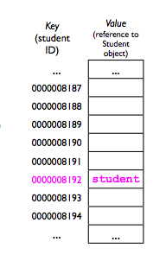
Finite “universe” of objects to store
For example, if we have a UCSD student database and each student has an id, we could allocate an array 4 billion elements long.
Whenever we want to find a particular student,
we simply jump to that student’s slot using the
student ID as the index.
When adding a student, we simply insert an entry at his/her unique location.
(IDs are guaranteed to be unique).

Slide 12
Running time?
Class StudentDataBase {
Student[] allStudents = new Student [4294967268];
void add (Student s) {
int index = s.studentId;
allStudents[index]=s; }
student get (Student s) {
int index = s.studentId;
return allStudent[index]; }
void remove(Student s) {
int index = s.studentId;
allStudents[index] = null;}

Slide 13
Space complexity is horrible ☹
Allocating 4 billion entries for a UCSD student database is extremely wasteful.
The universe of keys is far larger than the number we expect to ever want to store.
What if we decreased the size of the table from 4 billion entries to storing, say, just 100,000?
100,000 is still far higher than the actual number of UCSD students, so there should be plenty of space.

Slide 14

Collision
With an array of only 100,000 entries, each student ID would no longer have its own unique array index -- multiple student IDs would have to “share” an index.
We call the “sharing” of an array index by 2 (or more) student IDs a collision.
Whenever a collision occurs, we have to store the Student object “somewhere else” (more later).

Slide 15

Collision
However, if we’re clever about how we assign array indices to student IDs, then collisions will rarely occur.
We can still achieve O(1+..) add/find/remove time in the average case.

Slide 16
Idea: Hash Tables
A hash table consists of a large array of M “slots” (or “buckets”) to store the user’s data.
A hash table also requires:
Some way of converting from an object’s key into an index that specifies where that object should be stored.
This is called a hash function.
A method of handling collisions.
In order to ensure good performance, M (number of cells) must be bigger than N, the number of data the user will want to store.

Slide 17
Do we have a collision?
M=5;
Student1 id is 1;
Student2 id is 4;
Student3 id is 8;
A: Yes
B: No
C: May be

Slide 18
Hash function
A hash function maps an object’s key into an array index, i.e., a number from 0...M-1, where M is the number of entries in the hash table.
Example:
int hashFucntion (int studentID){
return studentID % M; }
The modulus operator % divides studentID by M, and then returns the remainder. Examples:
3 % 10 = ?
107 % 10 = 7
7 % 4=3
16 % 5 = 1

Slide 19
Do we have a collision?
M=5;
Student1 id is 1;
Student2 id is 4;
Student3 id is 8;
A: Yes
B: No
C: May be

Slide 20
Hash function
To be useful, a hash function must be fast
Its performance should not depend on the particular key.
O(1+..) (otherwise how can we achieve desired O(1+..) performance? )
A hash function must also be deterministic:
Given the same key, it must always return the same array index. (Otherwise, how would we find something we stored earlier?)
A “good” hash function should also be uniform:
Each “slot” i in the array should be equally likely to be chosen as any other slot j.

Slide 21
Is it a good hash function?
int hashFucntion (int studentID){
return M/2; } //M is a size of a HT
A: Yes,
B: No, it is not fast
C: No, it is not deterministic
D: No, it is not uniform

Slide 22
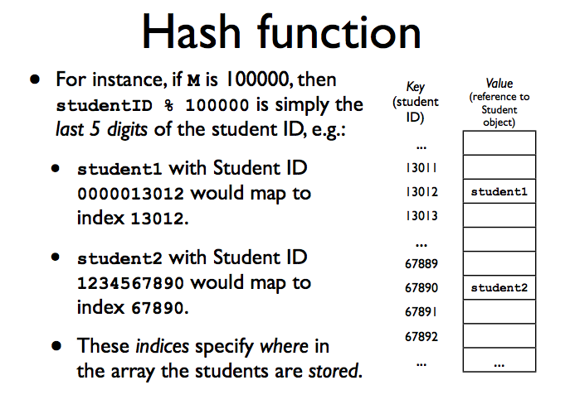

Slide 23
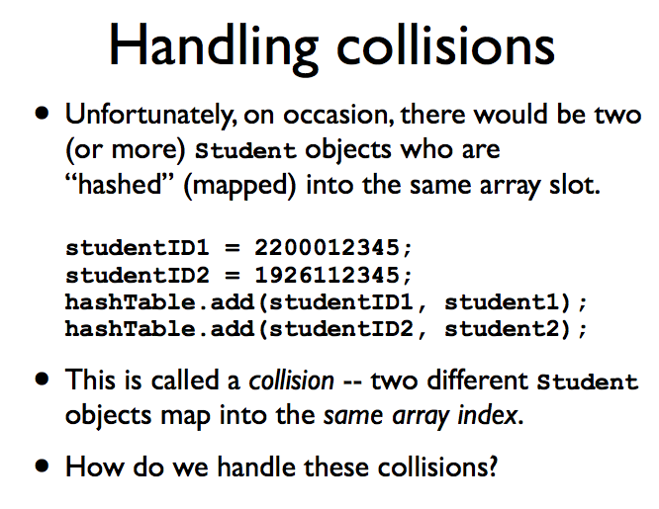

Slide 24
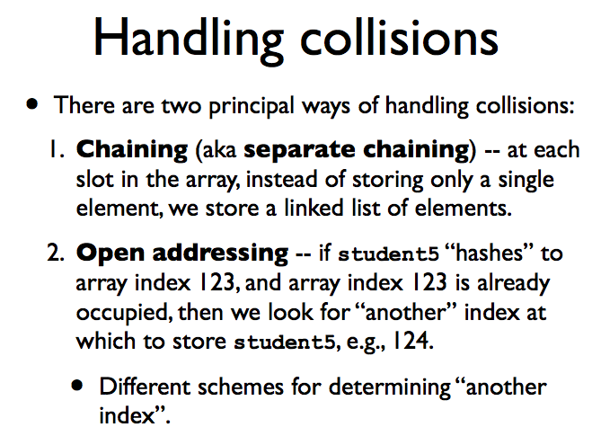

Slide 25
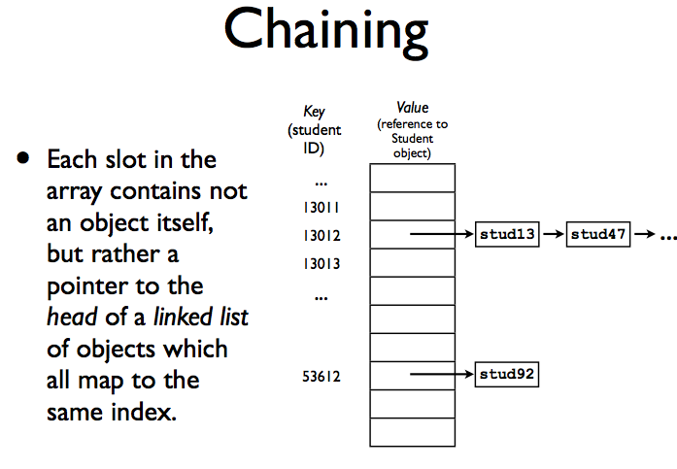

Slide 26
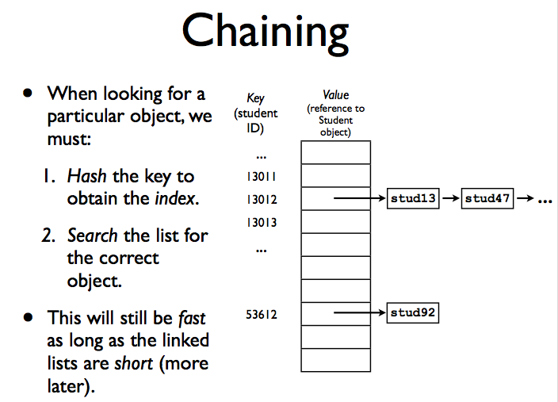

Slide 27
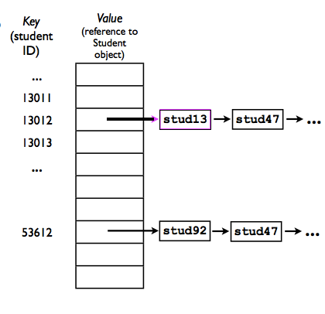
Assume a good hash function
Is this possible?
A: Yes
B: No
C: Sometimes

Slide 28
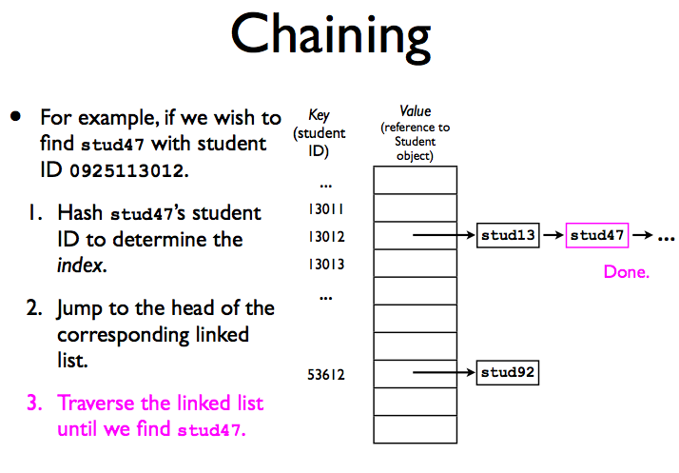

Slide 29
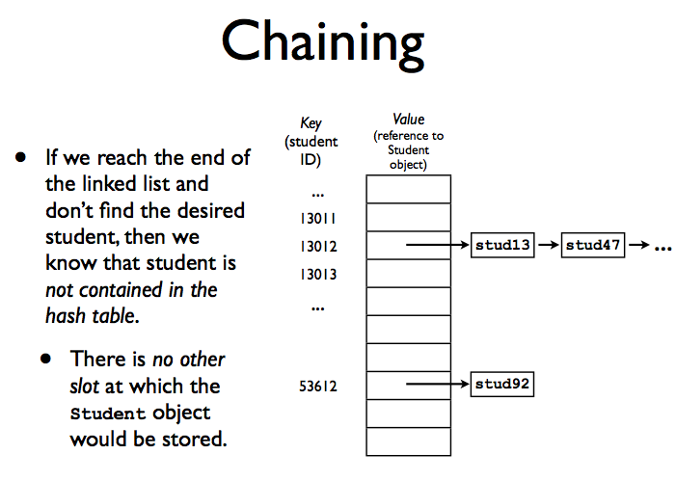

Slide 30
Chaining: complexity
How fast are the add/remove/find operations for a hash table with chaining?
To find an object in a hash table, we must:
Hash the key. A: O(1), B: O(n), C: unknown
Jump to that array index. A: O(1), B: O(n), C: unknown
Traverse through the linked list at that index (average).
A: O(1)
B: O(n)
C: unknown

Slide 31
Chaining: performance analysis
In the worst case, all N objects stored in the hash table will hash to the same array index.
This means that the linked list at that index will be N elements long.
To find an arbitrary element in a linked list we need O(N) time.
This is no better than just using a linked list by itself!

Slide 32
Chaining: performance analysis
However, in the average case, a hash table performs much better:
Given M slots in the array and N objects to store, the average list length for any array slot is N/M. (Goes without proof)
Then, the average time to access any arbitrary object is
O(1+N/M). (Goes without proof).
Now, suppose that we always make sure that M>N:
Then N/M < 1.
Therefor, average-case time cost is O(1+N/M) = O(1)

Slide 33
Load factor
Load factor α = N/M of the hash table.
The proper way to report a running time for hash tables is:
O(1+α), where α is a load factor. If α becomes too large, then the running time is not a constant anymore.
For separating chaining load factor of 1 is OK. If it becomes larger:
double the size of the table and rehash.

Slide 34
Open addressing
Another way to resolve a collision

Slide 35
Idea
In a case of a collision we look for another available cell.
Must be deterministic
If we want to find an element, we should visit the same cells.

Slide 36
Simplest: linear probing
If hashFunction(key) maps into an index i that is already occupied, then try i+1.
If that doesn’t work, try i+2, i+3, ..., etc.
If we get to M-1, we want to “wrap around” back to 0.
The index of the jth probe (where j starts at 0) is given by the expression (i+j) % M
You can think of the probe as one step in your search

Slide 37
Exercise
The index of the jth probe (where j starts at 0) is given by the expression (i+j) % M
Insert the given numbers in the hash table (M=7), resolving collisions by linear probing ( use %M for hash function)
1, 15, 2, 7, 14, 22

Slide 38
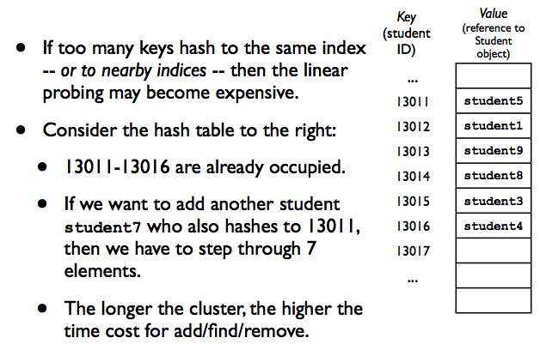
Primary clustering

Slide 39
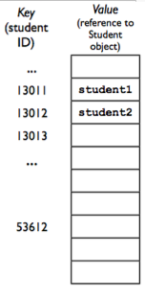
Removing an element
Suppose we want to remove student1
from the hash table:
Table[13011] = null;
Can I do it?
A: Yes.
B: No
C: Seems like a bad idea but I do not
know why.

Slide 40
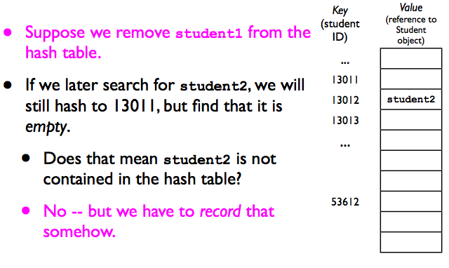
Removing an element

Slide 41
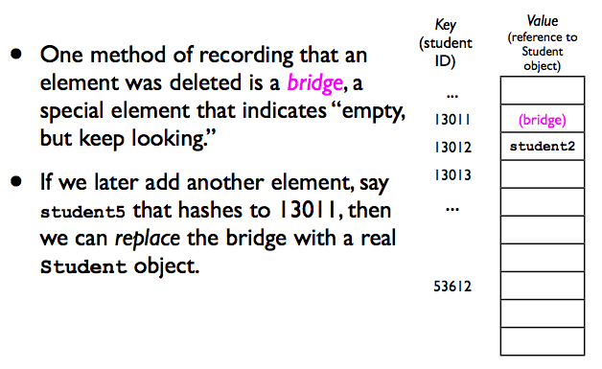
Removing an element (lazy deletion)

Slide 42
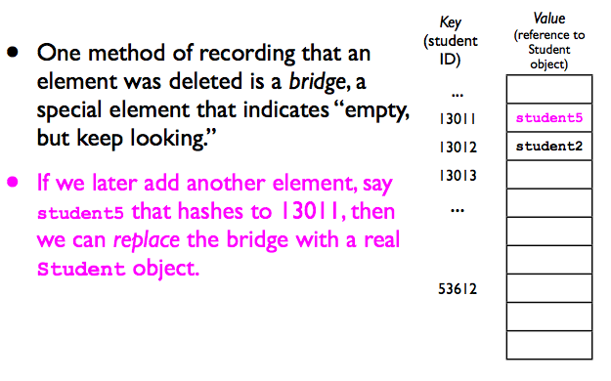
Removing an element

Slide 43
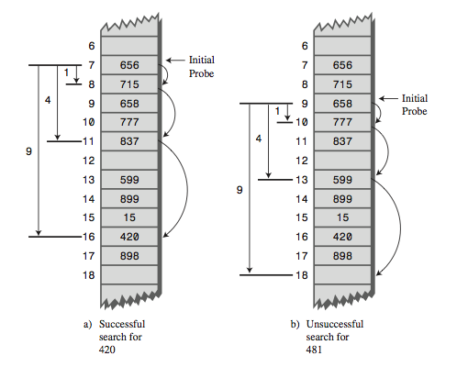
Quadratic probing
Quadratic probing is an attempt to keep clusters from forming. The idea is to probe more widely separated cells, instead of those adjacent to the primary hash site.
In quadratic probing, probes go to x+1, x+4, x+9, x+16, x+25, and so on. The distance from the initial probe is the square of the step number: x+1², x+2², x+3², x+4², x+5², and so on.

Slide 44
The Problem with Quadratic Probes
Quadratic probes suffer from a different and more subtle clustering problem.
Let’s say 184, 302, 420, and 544 all hash to 1 and are inserted in this order.
What is the hash table after we insert these numbers? (assume the table is large enough)

Slide 45
The Problem with Quadratic Probes
Quadratic probes suffer from a different and more subtle clustering problem.
This occurs because all the keys that hash to a particular cell follow the same sequence in trying to find a vacant space.
Let’s say 184, 302, 420, and 544 all hash to 1 and are inserted in this order. Each additional item with a key that hashes to 1 will require a longer probe.
This phenomenon is called secondary clustering.
Secondary clustering is not a serious problem, but quadratic probing is not often used because there’s a slightly better solution.

Slide 46
Double Hashing
Idea: generate probe sequences that depend on the key instead of being the same for every key.
Then numbers with different keys that hash to the same index will use different probe sequences.
The solution is to hash the key a second time, using a different hash function, and use the result as the step size.
h(k, i) = (h₁(k) + i h₂ (k)) mod m.
h₁ and h₂ are auxiliary hash functions.
i is the probe step

Slide 47
Example: h(k, i) = (h₁(k) + i h₂ (k)) mod m.
Assume M = 13 (size of the table)
h₁(k) = k mod 13
h₂(k) = 1 + ( k mod 11).
Let’s insert 79, 69, 98, 72, 14, 50 using double hashing.

Slide 48
Restrictions on h₂
Experience has shown that this secondary hash function must have certain characteristics:
It must not be the same as the primary hash function.
It must never output a 0 (otherwise, there would be no step; every probe would land on the same cell, and the algorithm would go into an endless loop).

Slide 49
Analysis of open-address hashing
Load factor α=N/M of the hash table. Since at most one element occupies each slot and M=>N, α<=1.
Facts (without proof).
For linear probing the load factor can’t be more than 2/3 (under ½ is the best)
For quadratic probing and double hashing load factor of 2/3 is OK.
If the load factor increases, you must re-hash: create a larger array and re-hash every element into a new hash table.

